Slide 1
COVID -19 VACCINATIONS ANALYSIS
Team : 4E06
Chirag Biradar (521)
Jaswanth Reddy (530)
Ajay Kushal (527)
Bharath Sai (524)

Slide 2
PROBLEM STATEMENT
Forecasting of time taken for completing 100% total vaccinations of particular region over the time period.
By this, vaccine manufacturing companies get to know the prior requirements of vaccine which helps to produce the vaccines in large scale and complete the vaccination drive with in calculated time.

Slide 3
DATASETS AND ITS ATTRIBUTES
Vaccinations(data)
Vaccine_Names(vaccine)
Source: ourworldindata.org

Slide 4
Attribues of vaccinations dataset :
'people_vaccinated'
'people_fully_vaccinated'
'total_boosters'
'new_vaccinations'
'total_vaccinations_per_hundred'
'people_vaccinated_per_hundred'
'people_fully_vaccinated_per_hundred'
'total_boosters_per_hundred'
''population'
'population_density'
'median_age'
'aged_65_older'
'aged_70_older'
'human_per_capita'
'iso_code'
'continent'
'location'
'date'
'total_cases'
'new_cases'
'total_deaths'
'new_deaths'
'total_deaths_per_million'
'total_tests'
'new_tests'
'positive_rate'
'total_vaccinations'

Slide 5
Attributes of Vaccine_Names dataset :
'location'
'date'
'vaccine'
'total_vaccinations'
The Attributes present and one of the appropriate and relevant large dataset found was the reason for choosing these datasets.
The Attributes having null percentage of more than 85 are removed. Attributes which are most frequently used and require for analysing and visualizing are selected .

Slide 6
DATA PRE-PROCESSING

Slide 7
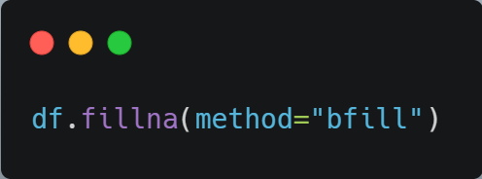
The 'BFILL' fills the missing values backward so they are replaced with the next value.
All the missing values of all tuples are now replaced by appropriate values

Slide 8
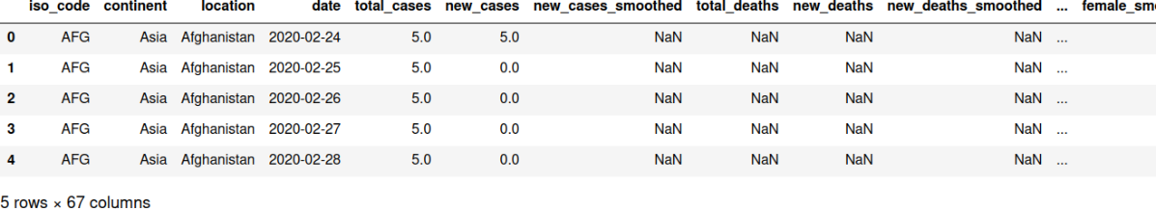
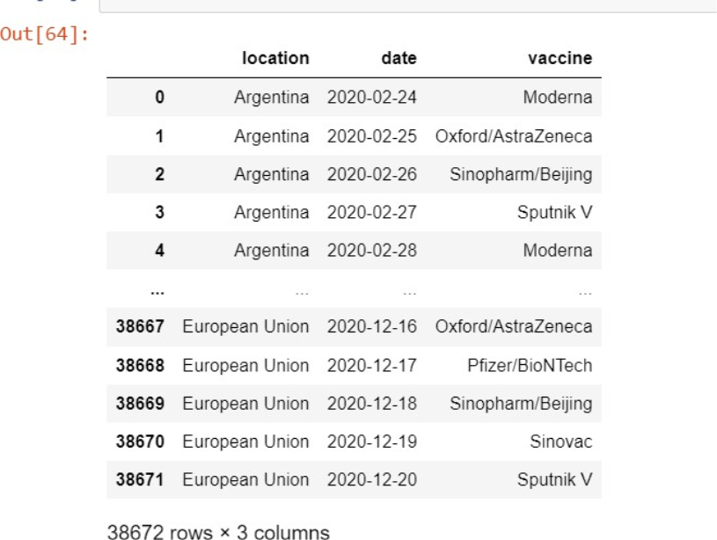
Merging of two datasets(data and vaccine)

Slide 9
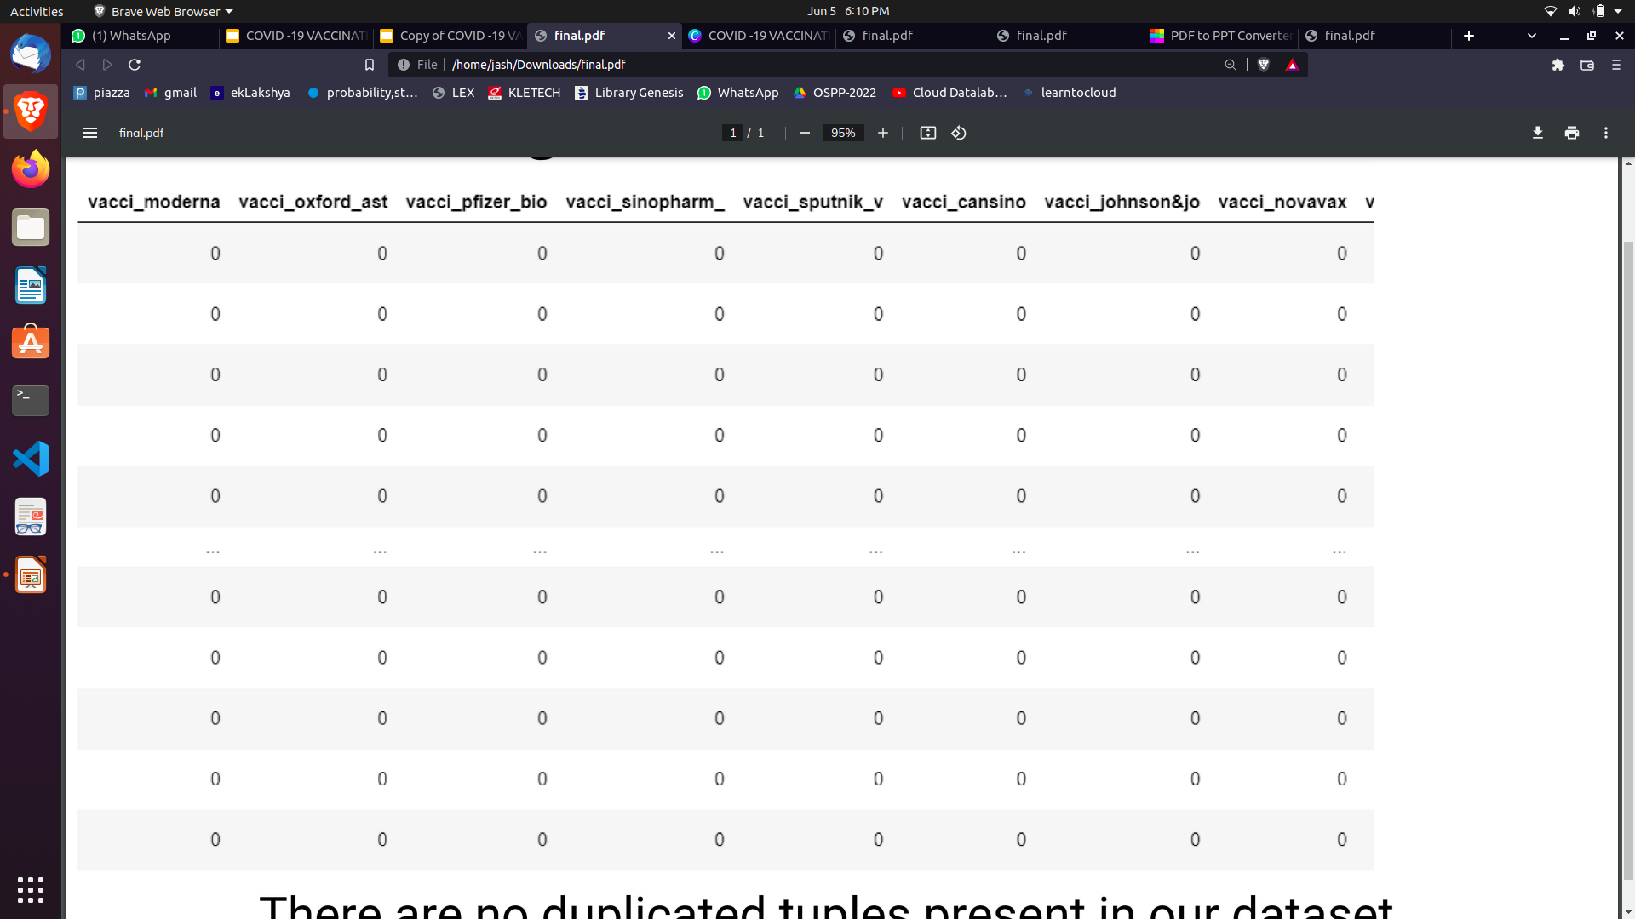
One hot encoding

Slide 10
QUESTIONS

Slide 11
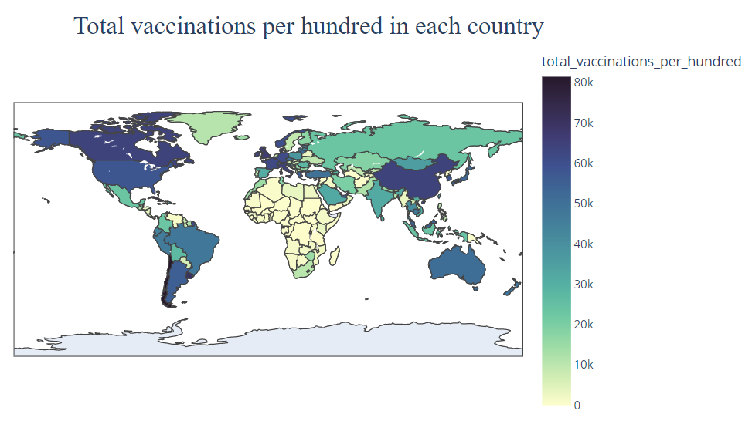
Compare the total vaccinations per hundred over all the regions of the world ?
North America,South America and countries with higher gdp have higher total vaccination per hundred

Slide 12
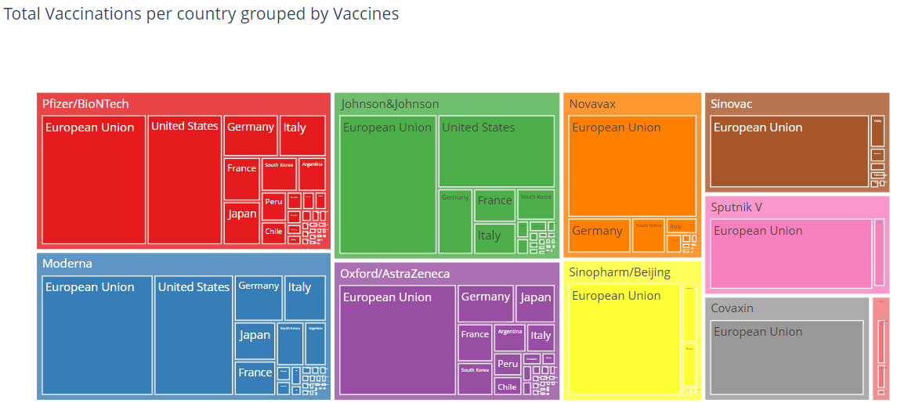
Which Vaccines are used in a region?
Vaccines like pfizer,Moderna are used by many countries where as vaccines like sinovac and sputnik are not approved in many countries

Slide 13
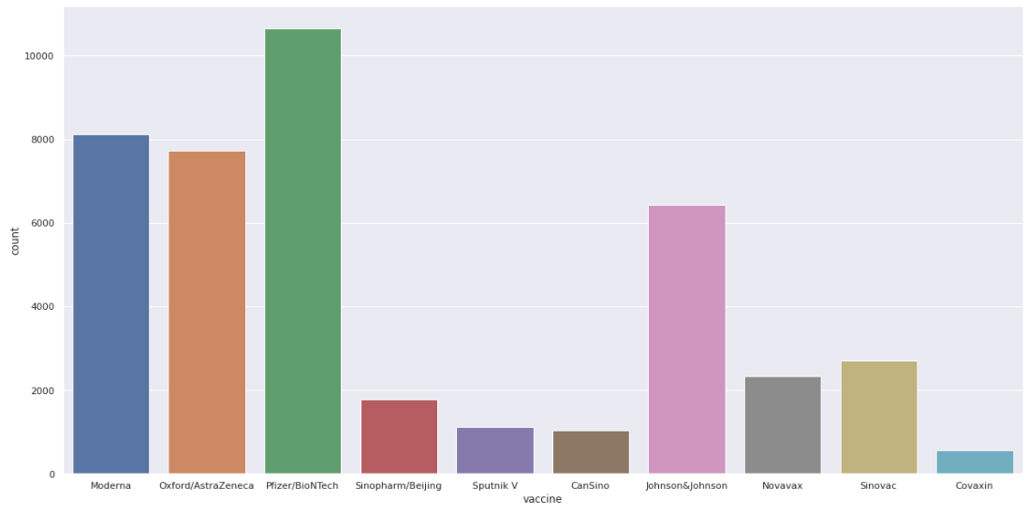
What is the most used vaccines in our data ?
In this analysis, x-axis is labelled using vaccine names and y-axis is labelled using count vaccines.Pfizer/BioNtech is the most widely used vaccine over the world and can be easily suggested in the future years also for the additional manufacturing of this vaccine.

Slide 14
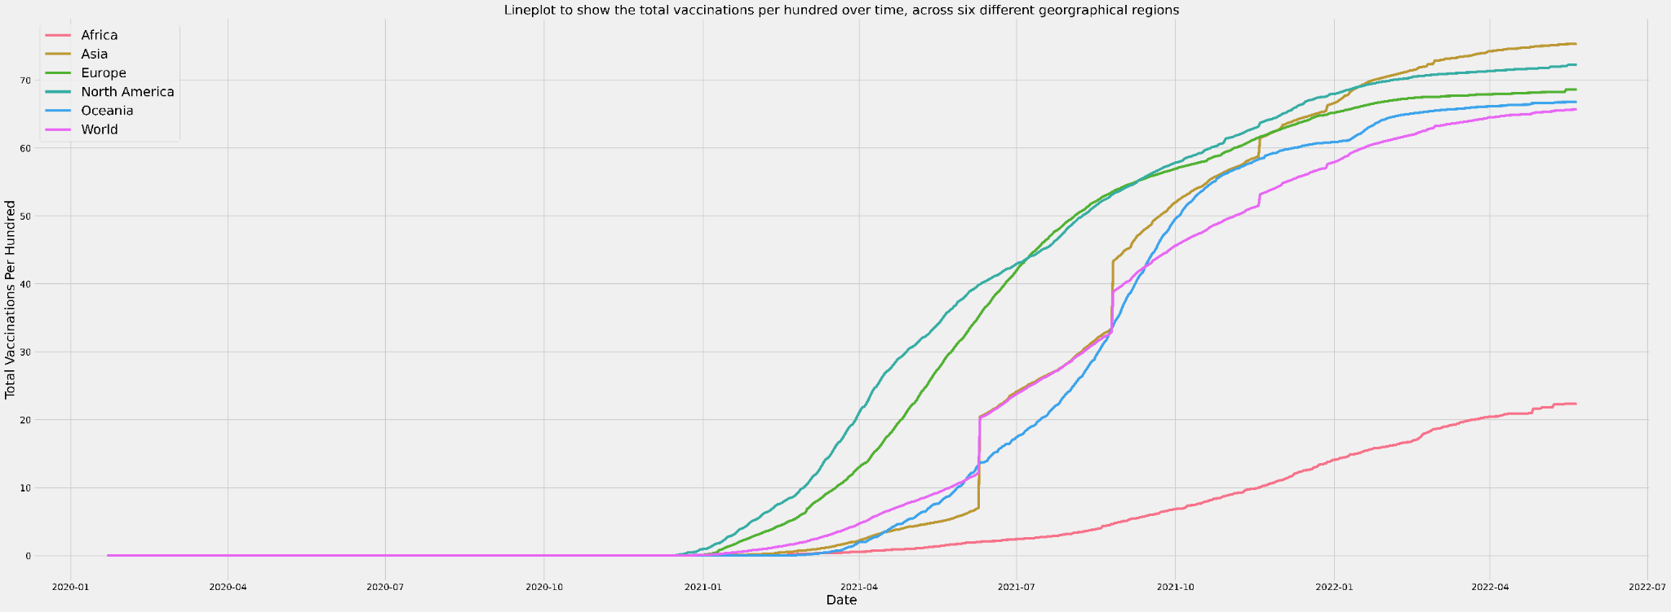
Analyse the trend of vaccinations across the regions?
This shows the trend of vaccinations over the time.Similarly we are going to predict the time taken for completion of fully vaccinated region and to calculate the average time taken for completion of vaccination across fully vaccinated region.

Slide 15
Data analysis and visualisation

Slide 16
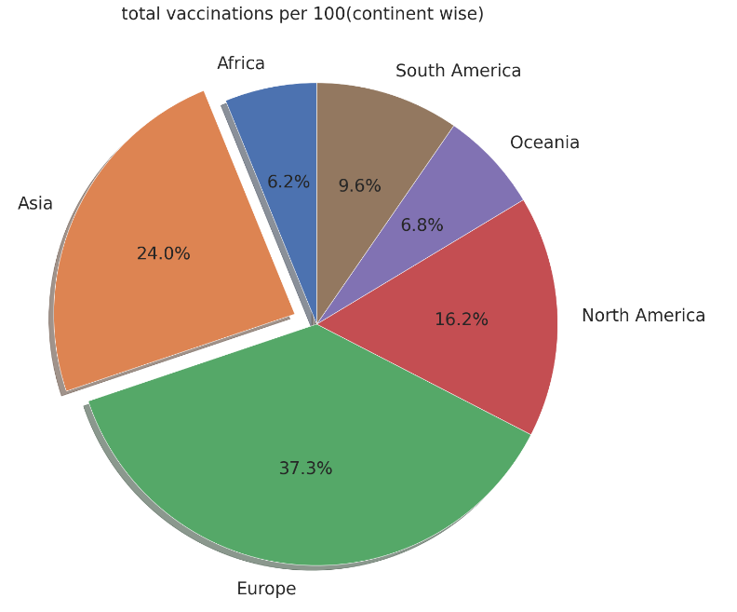
Asia and Europe have around 50 percent of all vaccinations.

Slide 17
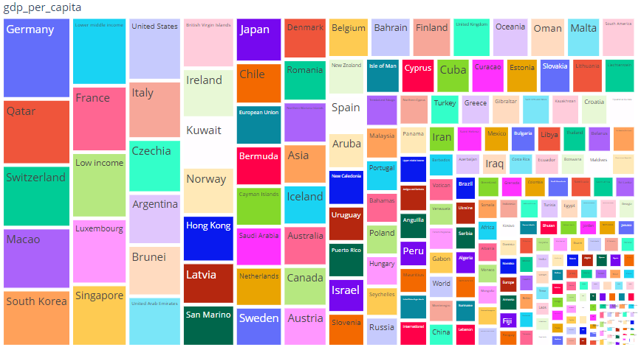
Germany, Switzerland, Qatar, Luxembourg has highest gdp per capita

Slide 18
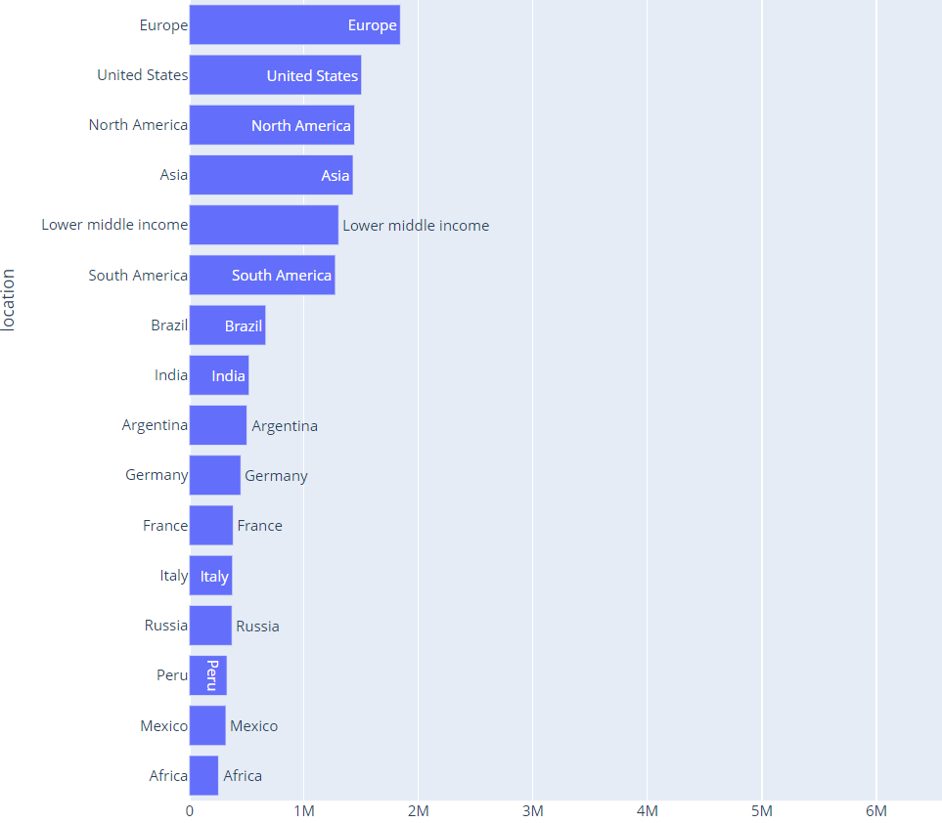
European Union has the highest new deaths

Slide 19
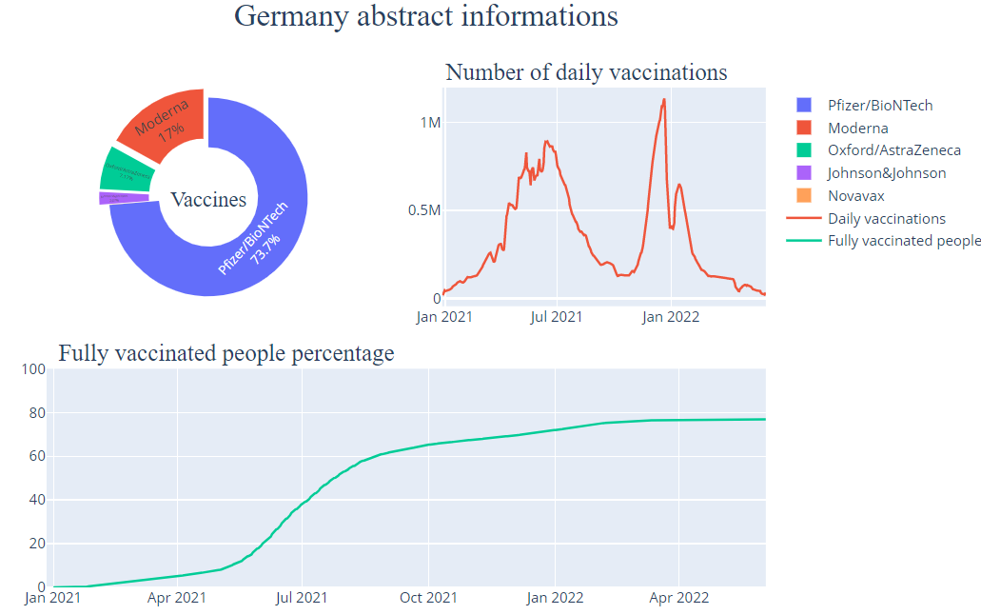

Slide 20
MODEL BUILDING

Slide 21
Time series forecasting using Huber regressor
Time Series Analysis is the way of studying the characteristics of the response variable with respect to time, as the independent variable.
our dataset contains data points which typically consists of successive measurement made from the same source over a time interval.

Slide 22

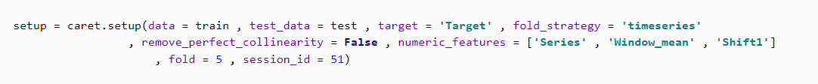
PyCaret is an open-source machine learning library that automates machine workflows.
This library helps in deciding which model is more efficient for a given method.

Slide 23
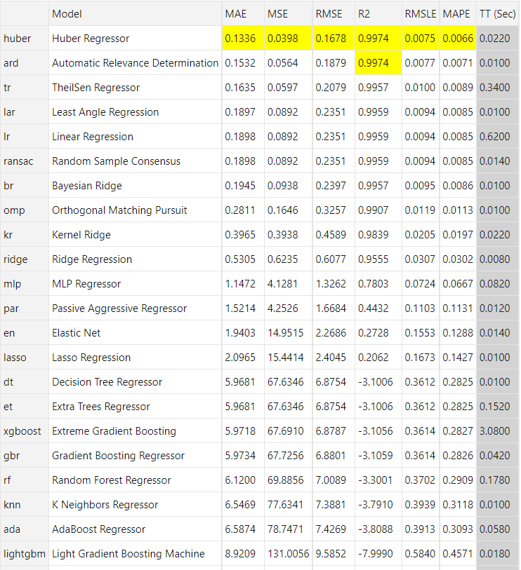
We can observe that by testing all possible models we are getting Huber regression fits best.

Slide 24
Huber Regression
In statistics, Huber loss is a particular loss function (first introduced in 1964 by Peter Jost Huber, a Swiss mathematician) that is used widely for robust regression problems — situations where outliers are present that can degrade the performance and accuracy of least-squared-loss error based regression.
Huber regression is a type of robust regression that is aware of possibility of outliers in a dataset and assigns them less weight than other examples in the dataset.

Slide 25
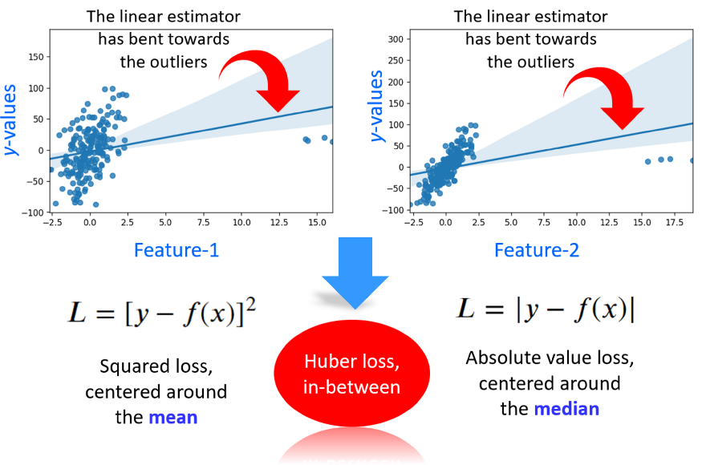

Slide 26
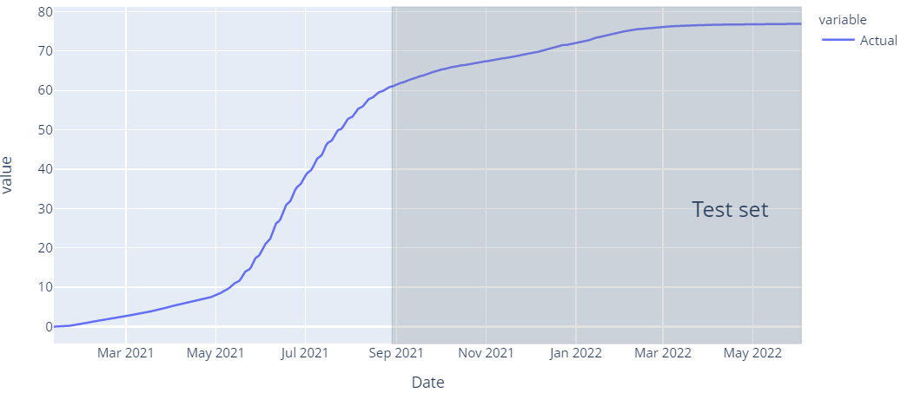
Given Data of vaccination per hundred of Germany
We can observe that about 76% of Germany’s population has been vaccinated

Slide 27
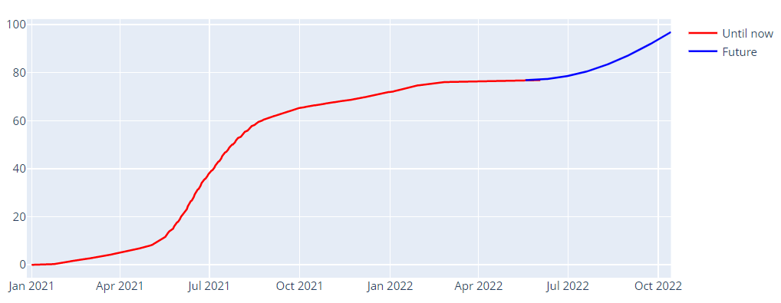
After forecasting using TS
After forecasting we can observe the at the end oct 2nd week vaccination completes in germany

Slide 28
CONCLUSIONS:
European union is one of the best example for the region which has many deaths and also which produced high number of total vaccinations. Also the gdp of countries of this region has not much different after pandemic.
Comparing the Root-mean-square error (rmse) and coefficient of discrimination(R2) values of models, Huber regression is selected with least RMSE of 0.1678 and R2 value of 0.9974 as the best model to predict the total vaccinations of particular region over the time period.
According to our model,Total Vaccinations of Germany might be completed by 2nd week of October.

Slide 29
Future Scope
Governments can improve the vaccination facilities and availability of vaccines to different locations by referring demand of vaccines and by referring most used vaccines across different countries.
The synthesis of current research will be helpful to researchers analysing historical trends in COVID-19 pandemic and individuals interested in better understanding and advocating for understanding and advocating for underserved communities across the globe.

Slide 30
Reference
https://ourworldindata.org/covid-vaccinations
https://www.analyticsvidhya.com/blog/2019/12/6-powerful-feature-engineering-techniques-time-series/
https://www.sciencedirect.com/science/article/pii/S2211379721006197
https://pycaret.gitbook.io/docs/
https://github.com/owid/covid-19-data/tree/master/public/data/vaccinations
https://towardsdatascience.com/regression-in-the-face-of-messy-outliers-try-huber-regressor-3a54ddc12516
https://www.nature.com/articles/s41598-022-05915-3
https://journals.plos.org/plosone/article?id=10.1371/journal.pone.0253925
https://machinelearningmastery.com/robust-regression-for-machine-learning-in-python/

Slide 31
Thank You

